Slide 1
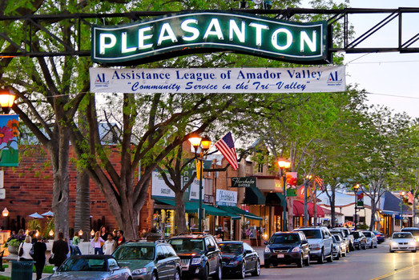
Project Luther: Predicting House Prices in Pleasanton, California
Benjamin Sturm
April 27, 2018

Slide 2
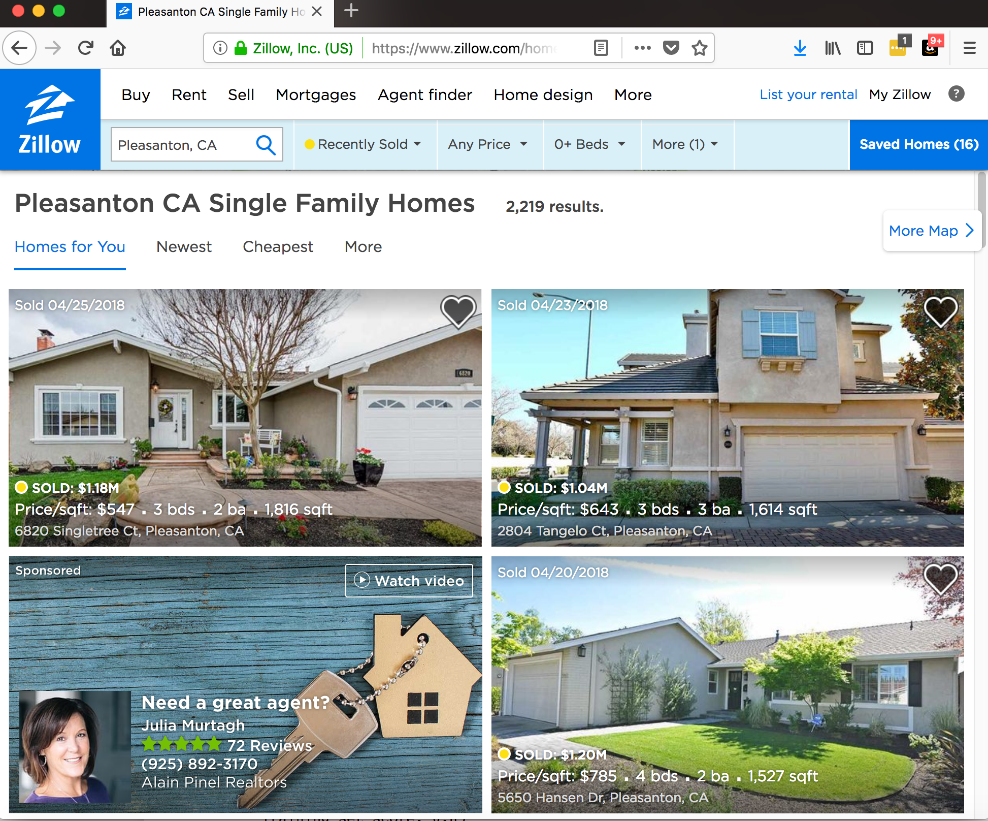
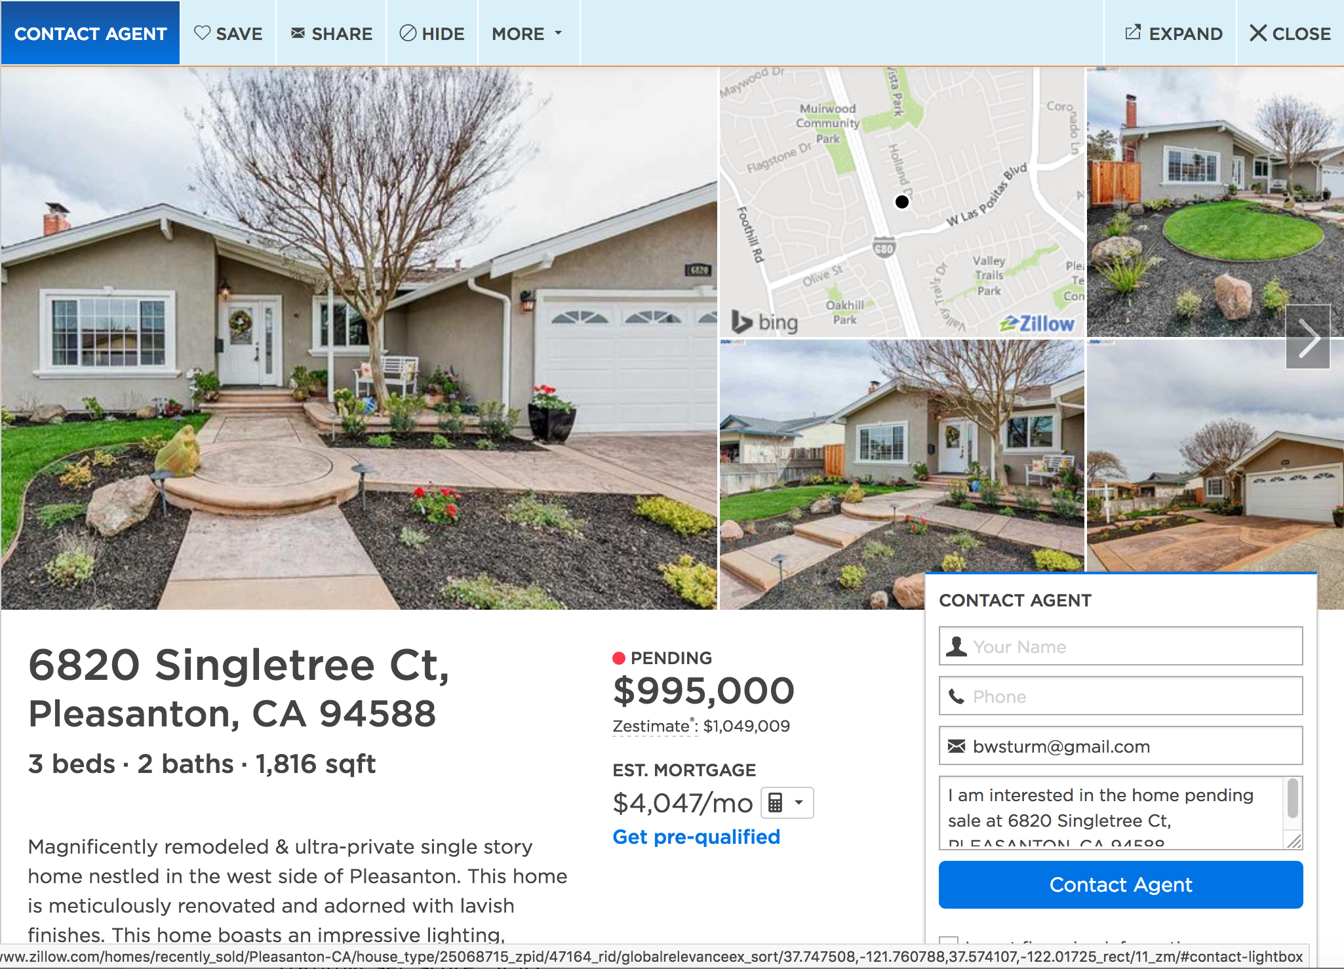
Zillow house price data was scraped using Selenium and Beautiful Soup
Data that was scraped:
Address, City, Zip, Bedrooms, Bathrooms,
Floor Size, Lot Size, Year Built, Sale Date, Sale Price
Notes:
Other data that could be predictive: Key phrases: “Newly updated”, “Updated kitchen”, “Remodeled kitchen”, Has a pool

Slide 3
How accurately can I predict house prices for recently sold homes?
Possible uses for this model:
To help the buyer determine if they are getting a fair price on a particular home
To help the seller when listing a home

Slide 4
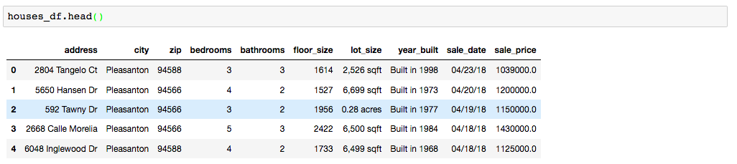
After scraping, I had data from 500 houses
Data cleaning process:
convert all strings to numerical values
drop any rows that had NaNs
convert acres to sqft
convert sale date to datetime format
create new columns corresponding to sale month and sale year
Post data cleaning resulted in 458 house listings

Slide 5
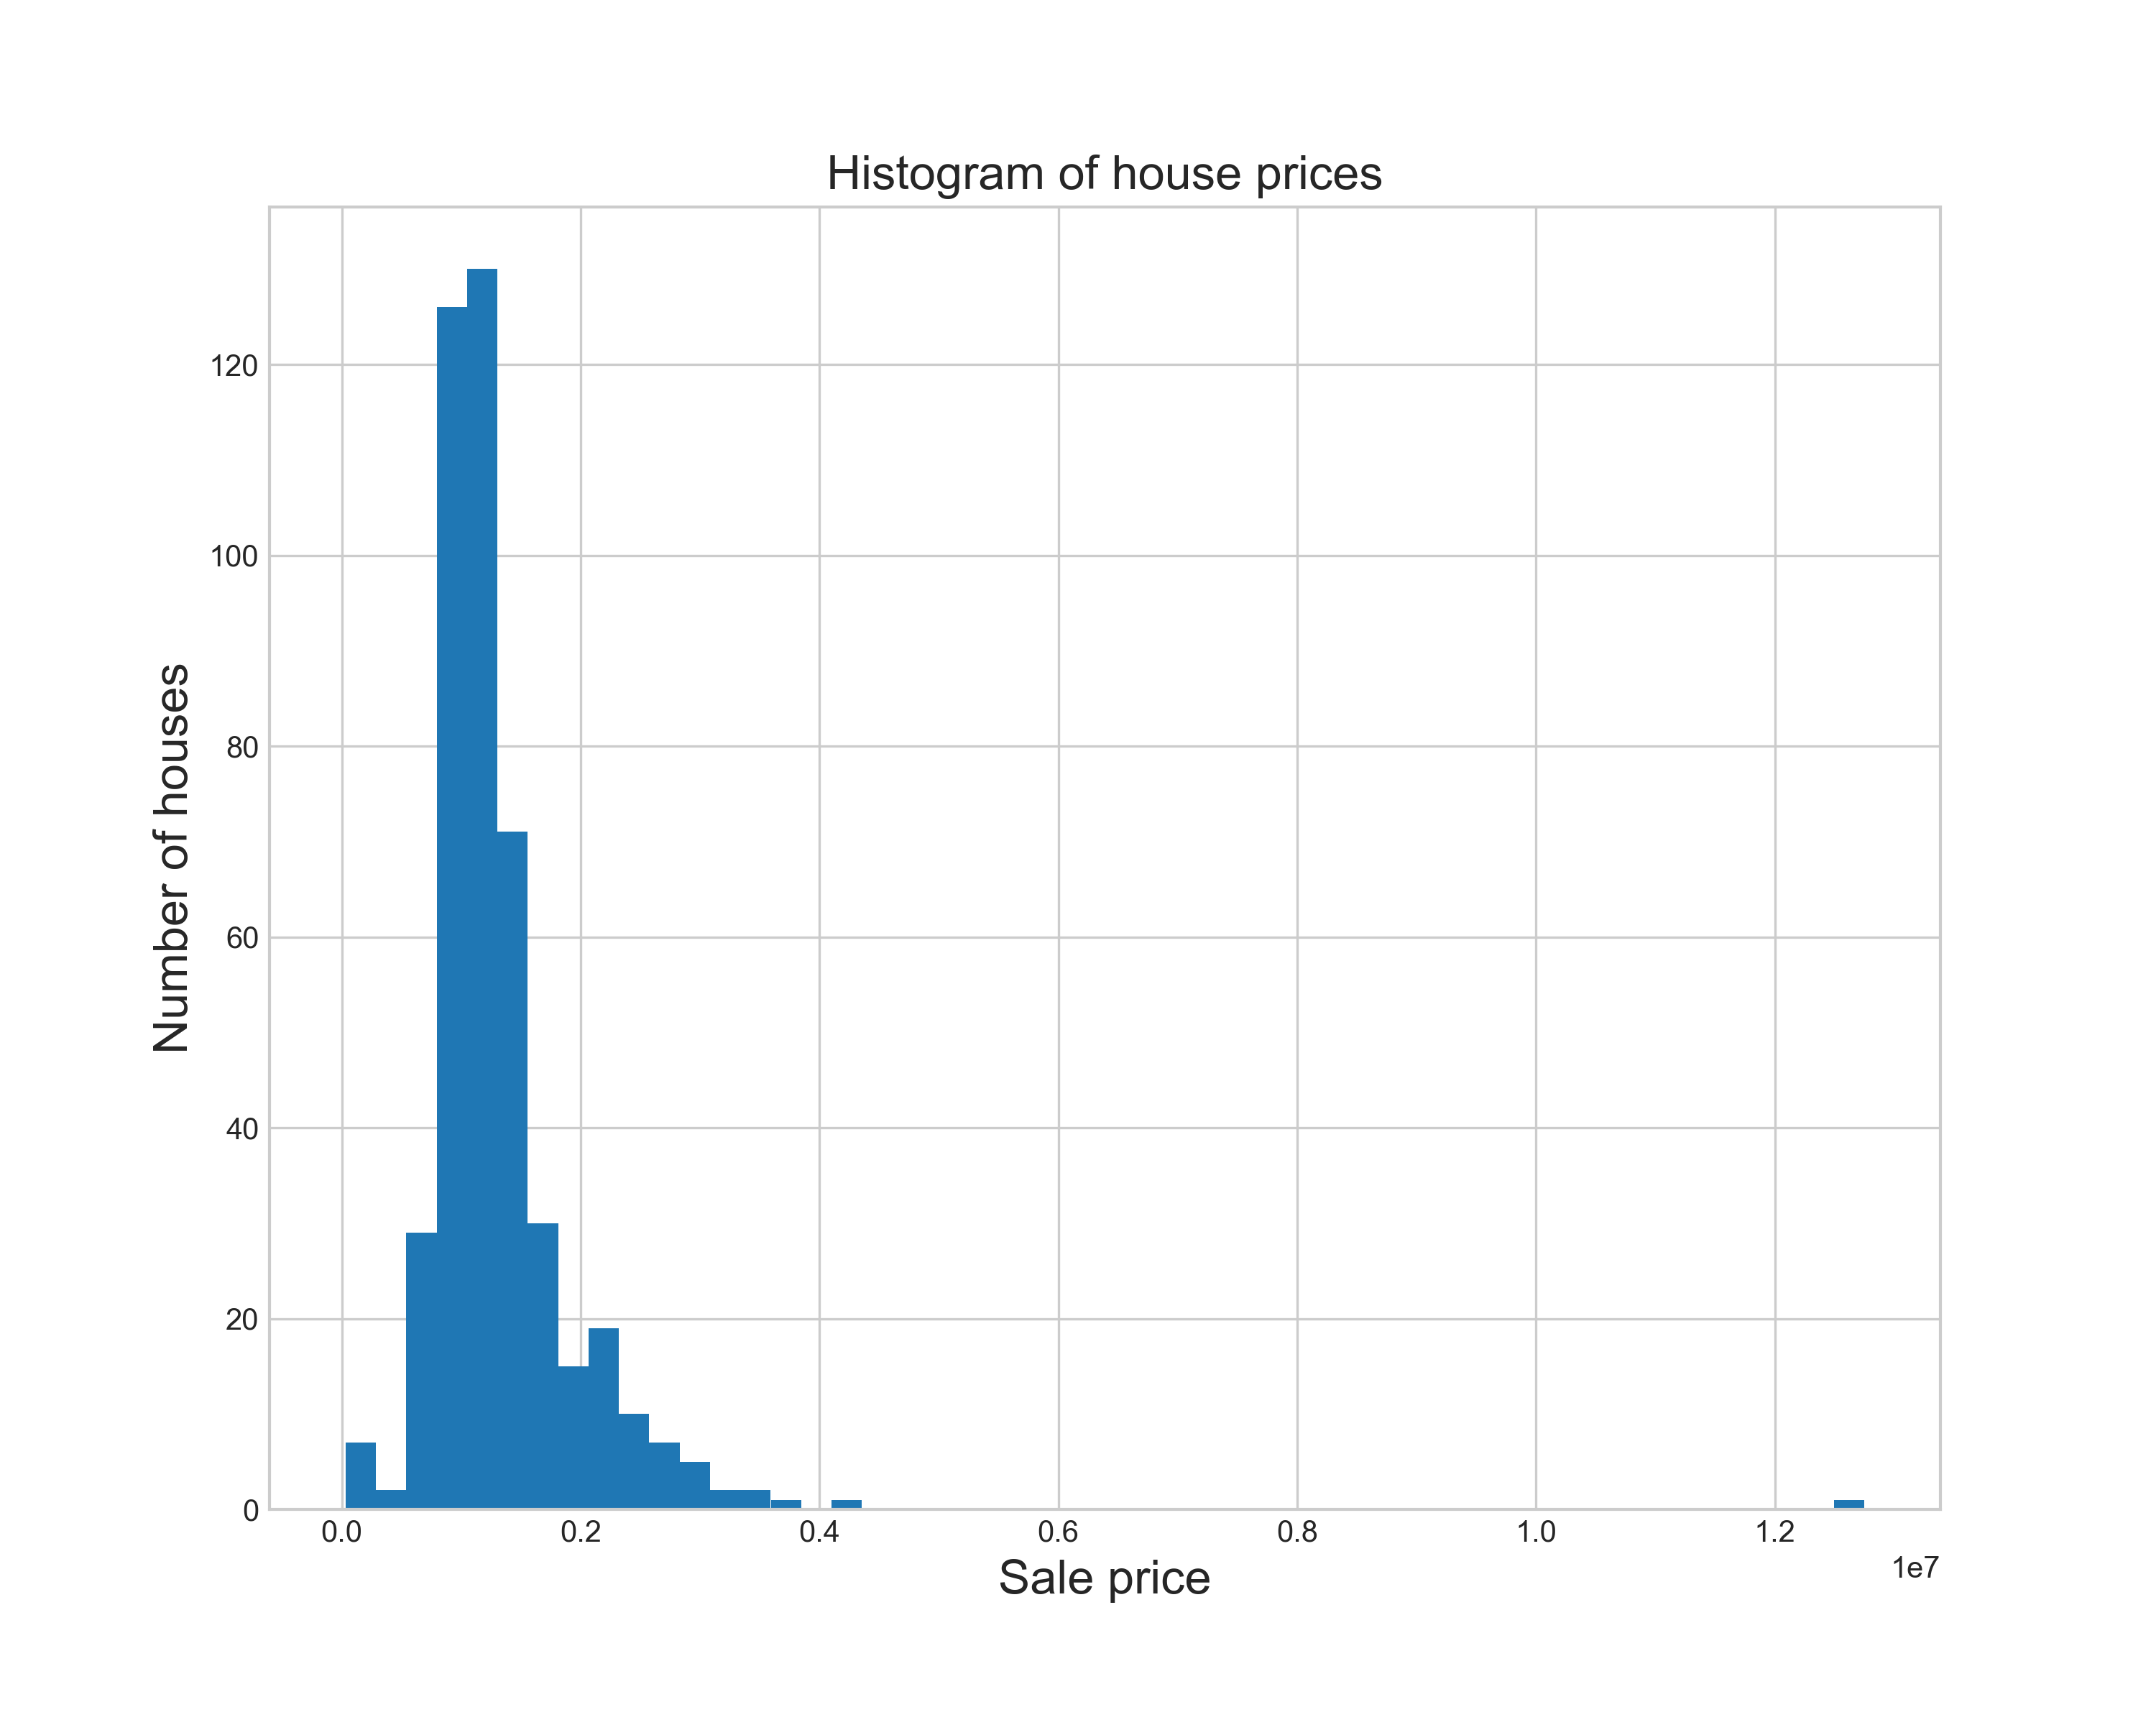
The distribution of the sale price data showed some outliers
Notes:
There is some skew to this data. Future analysis should involve doing a log transform on this data.

Slide 6
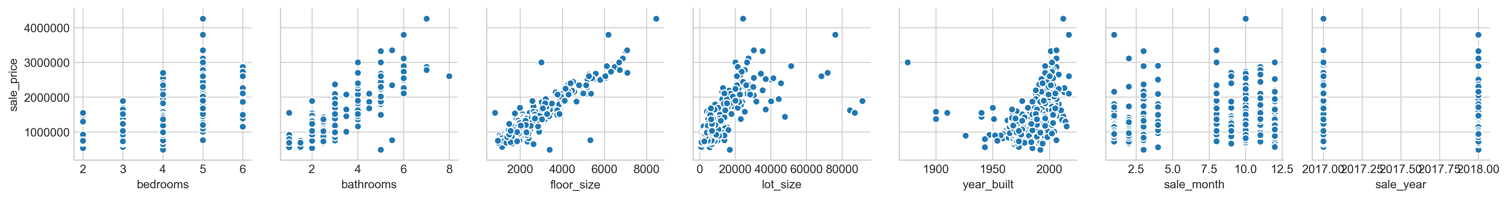
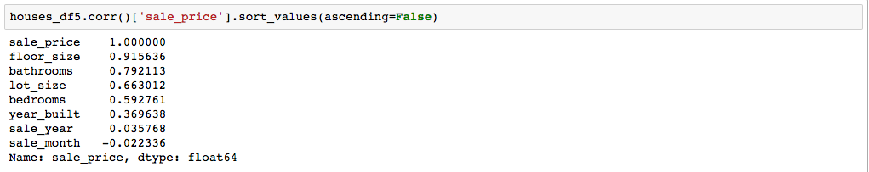
The pair plot data indicates a few features are quit predictive of price
The correlation data shows I may be able to get a reasonable model just using floor_size

Slide 7
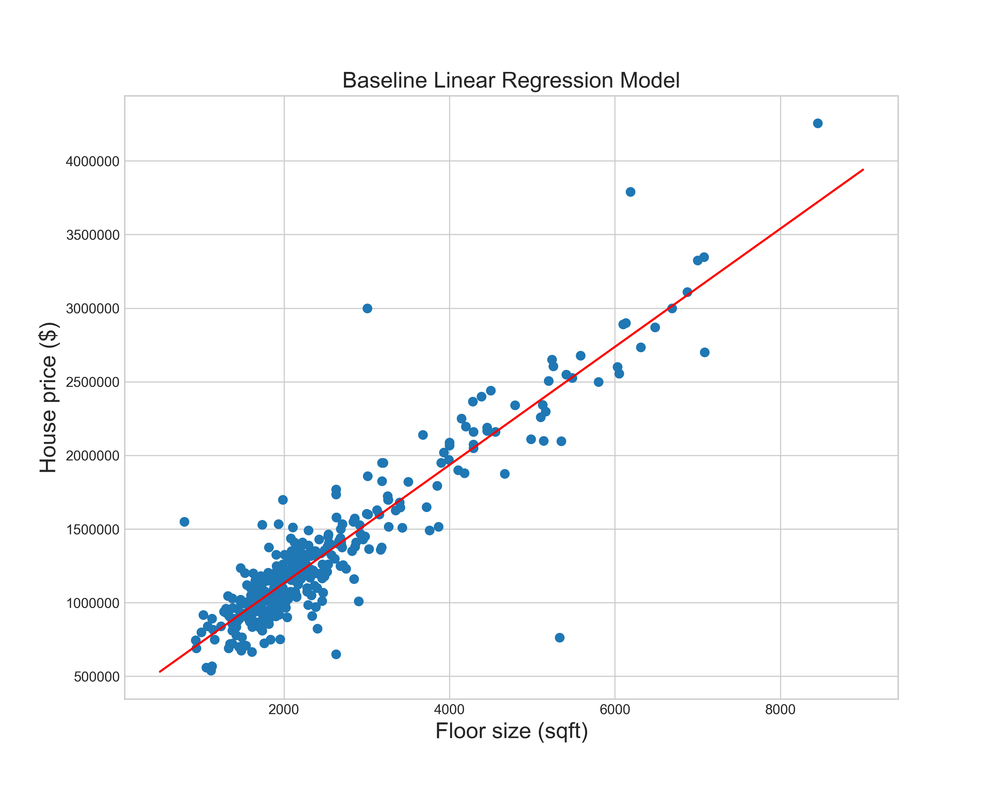
The baseline model using one feature does a good job at predicting price
R² scores
 | Baseline LR model
# features | 1
Training set | 0.85
Cross validation set | 0.84

Slide 8
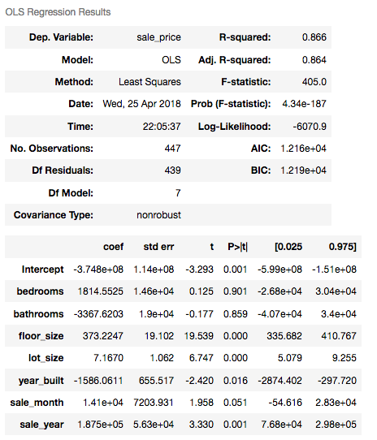
Linear regression using all features does slightly better
R² Results
 | Baseline LR model | Complete LR model
# features | 1 | 7
Training set | 0.85 | 0.87
Cross validation set | 0.84 | 0.84
The P-values indicate that bedrooms and bathrooms are not significant for predicting price

Slide 9
Also tried Lasso and Ridge regression, and Lasso gave way to slightly better scores
 | Baseline LR model | Complete LR model | Lasso Regression | Ridge Regression
# features | 1 | 7 | 6 | 7
Training set | 0.85 | 0.87 | 0.86 | 0.87
Cross validation set | 0.84 | 0.84 | 0.85 | 0.84
Bedrooms feature ignored with Lasso

Slide 10
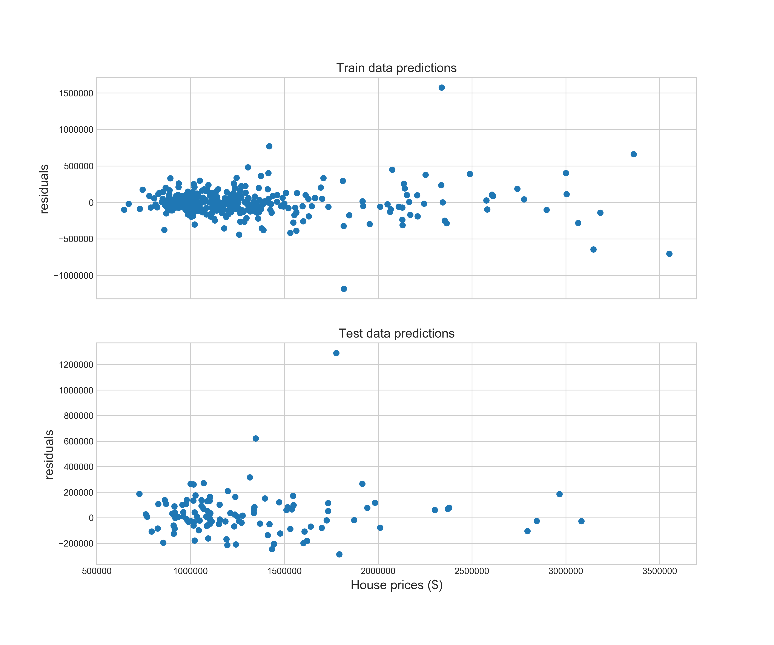
The residual plots for the Lasso regression model suggest that the linear model performs well across all house prices
The model is 86.5% accurate at predicting house prices in Pleasanton
 | Lasso Regression
# features | 6
Training set | 0.86
Cross validation set | 0.85
Test set score | 0.865

Slide 11
Next steps
Scrape more features and do it for more homes
Other good data to scrape
Key phrases: “Newly updated”, “Updated kitchen”, “Remodeled kitchen”
Indoor features: Fireplace, Central Air
Outdoor features: Patio, Pool
Incorporate geolocation data in model
Do log transform on the sale data to reduce the skew
Notes:
The geolocation data is important since house prices will be affected based on their proximity to busy roads/highways, parks, and distance to downtown.

